Slide 1
Secure IT!
ITS Summer Academy
Chris Davis

Slide 2
ITS Summer Academy Secure IT!
About the Class & Setting Expectations

Slide 3

Submarine NR-1
12 Man Crew
Nuclear Powered
Deep Submersible

Slide 4











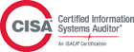
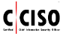
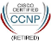
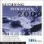
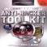
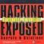
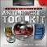
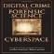
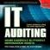
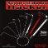
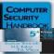
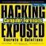
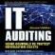
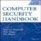
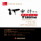





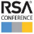





Your Instructor… Chris Davis! Um. Who?!
EDUCATION
Chris Davis
Visual Profile
Sr. Manager, Global Strategies
Compliance and Cyber Risk Solutions chrisdavis@vmware.com
EMPLOYMENT
http://www.cloudauditcontrols.com
http://www.linkedin.com/christopherdavis
CERTIFICATIONS
https://www.amazon.com/author/chrisdavis
PUBLICATIONS
PROJECTS & LARGE EVENTS
Notes:
Secure Chip Design
Product Manager
Security Operations
IT Auditing
NAC Engineer
Compliance and Assessments
Cloud Security Architect
Virtualization Compliance

Slide 5
Today's Agenda
PART 1 – Speed Drill – 1 Hour
Introductions
Tales from the Crypt & Why Security is Hot
Identity, Authentication, Encryption
PART 2 – Breaking Passwords – 1 Hour
Top 10 Password Cracking Methods
Cain
Offline NT Password & Registry Editor
Creating Strong Passwords
The Myth of Creating Strong Passwords
Storing Unique Passwords
PART 3 – Breaking Systems – 1 Hour
Why You Have the Advantage
Ring Theory & Real-World Examples
Social Engineering
Resources
Meta Sploit Demonstration

Slide 6
Eight Goals for This Discussion
Establish cautions of use of this talk and material
Conceptualize content clearly
Speak plainly
Frame a range of information security concepts
Describe the application of learned security concepts at the enterprise level
Establish some present & future information security challenges
Stimulate the exchange of ideas
Answer your questions fully
Boiler Plate Agreement

Slide 7
PART 1

Slide 8
Infosec Speed Drill
Introductions
Tales from the Crypt
Why Security is Hot
Access Control

Slide 9
Introductions

Slide 10

Community. Village raising a warrior.

Slide 11
Tales from the Crypt

Slide 12
A Walk on the Wild Side. Tales from the Crypt.

Slide 13
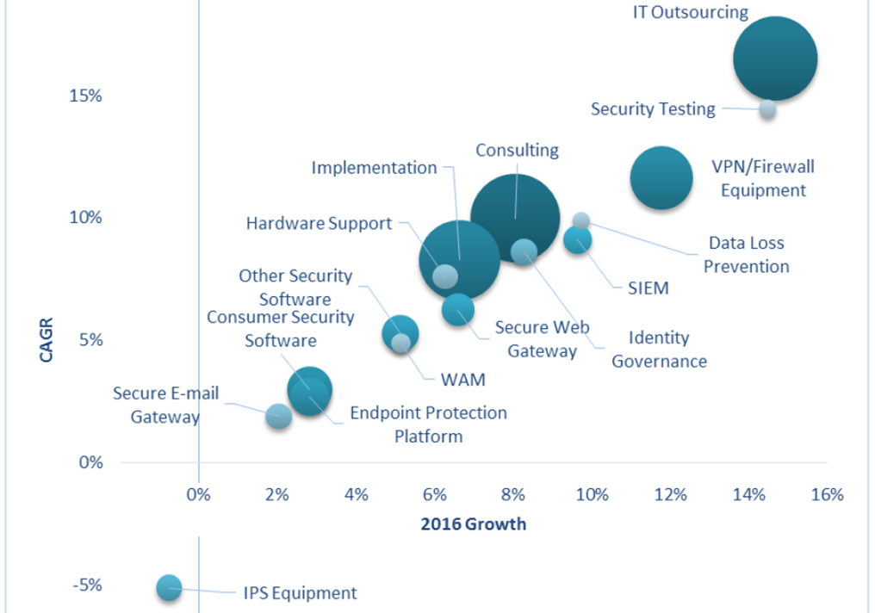
IT Spending Forecast, 4Q15 Update: What Will Make Headlines in 2016?
2016 Security spend exceeds $84.3 billion!
Market Trends
Secure Cloud/SaaS
Behavioral Analysis
Algorithmic Security
IoT
Analytics
Intel Sharing
http://www.gartner.com/webinar/3178622

Slide 14
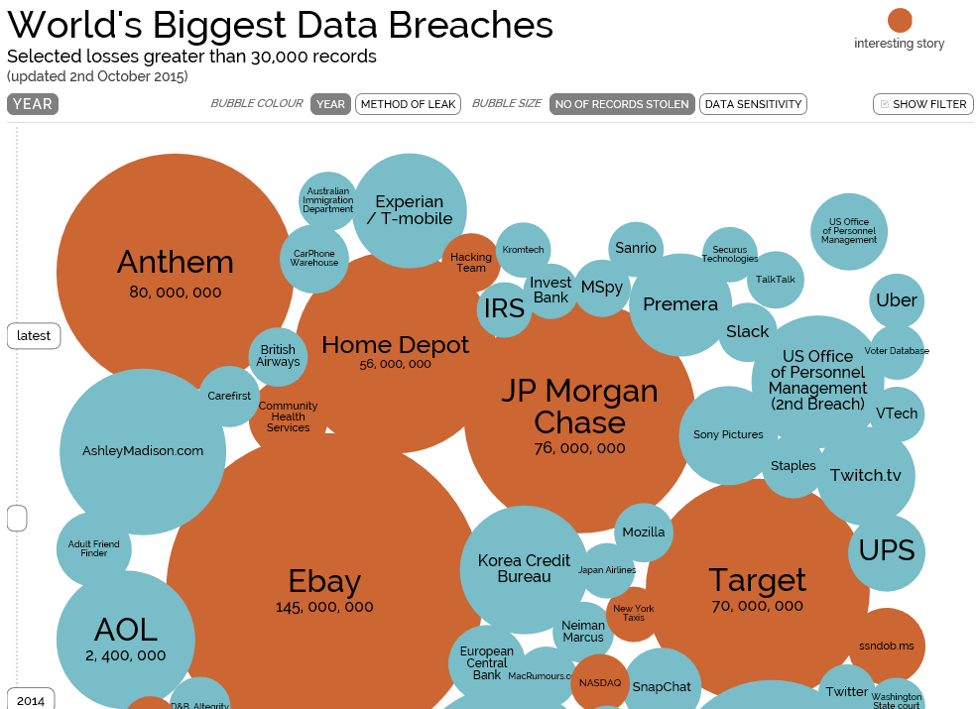
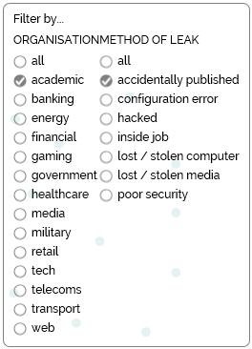
http://www.informationisbeautiful.net/visualizations/worlds-biggest-data-breaches-hacks/

Slide 15
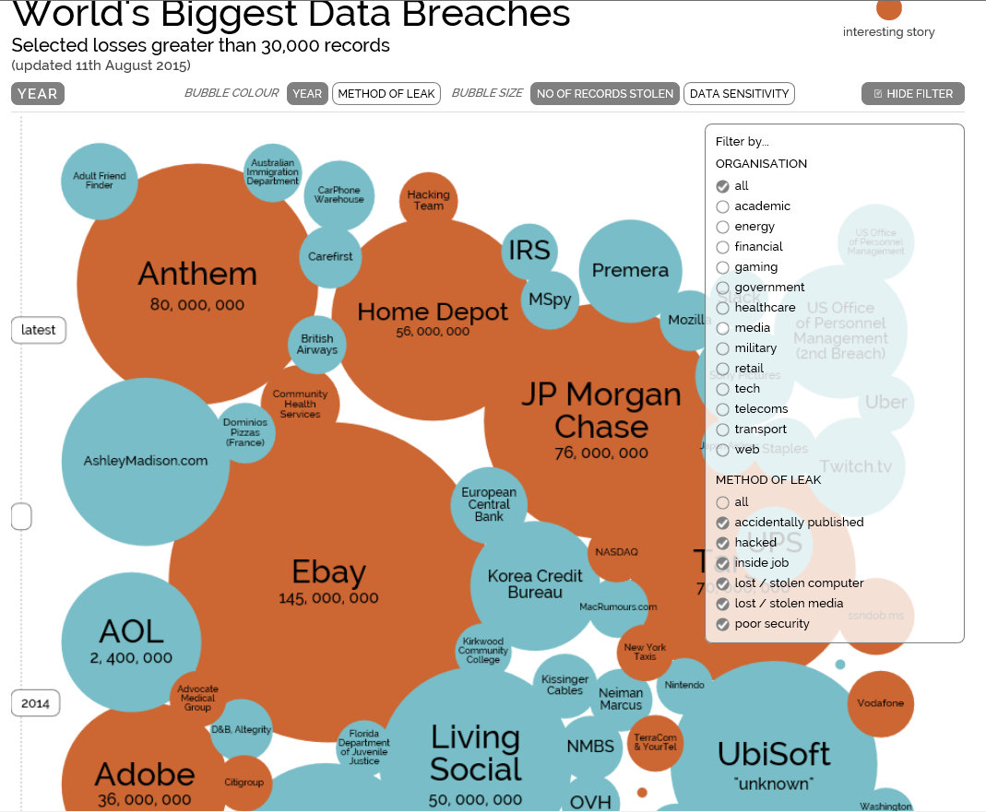
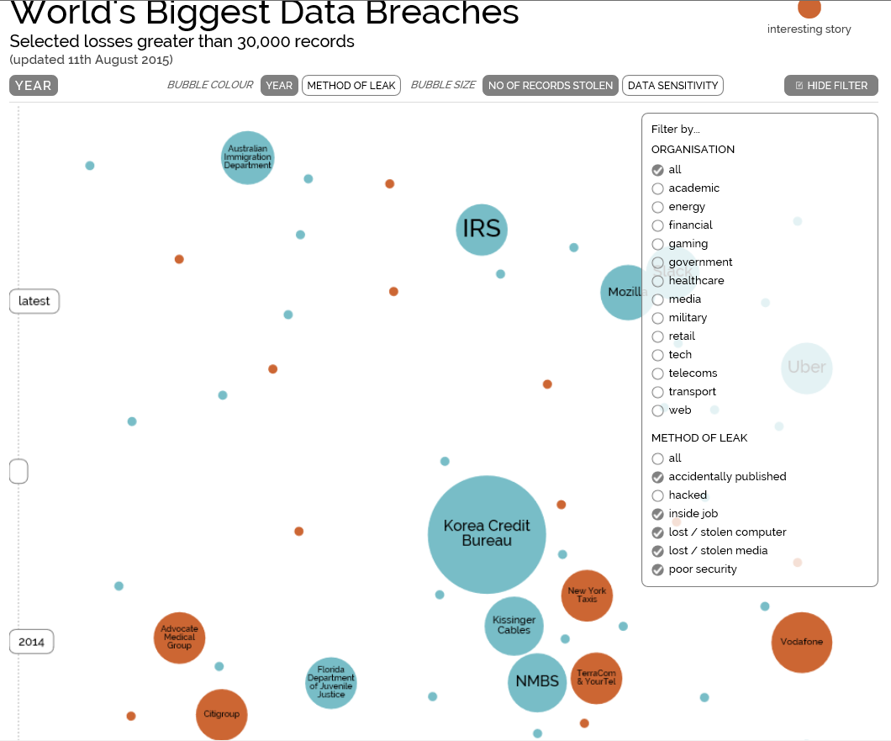
http://www.informationisbeautiful.net/visualizations/worlds-biggest-data-breaches-hacks/

Slide 16

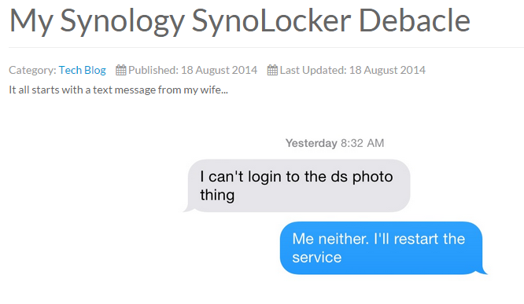
http://kendrickcoleman.com

Slide 17
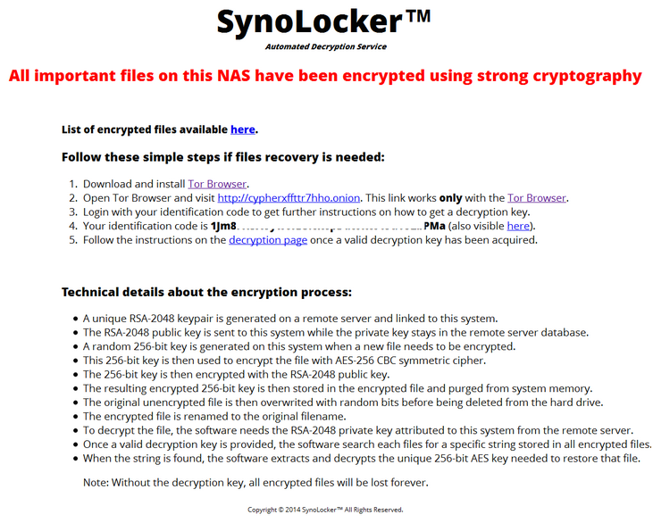

Slide 18
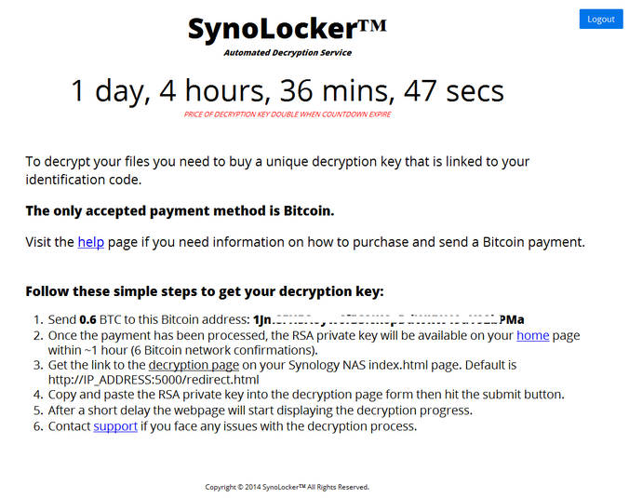

Slide 19
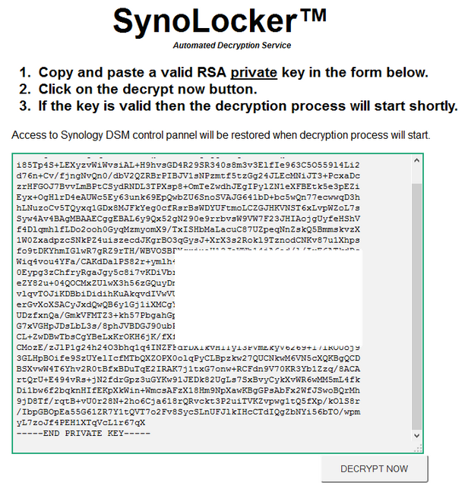

Slide 20
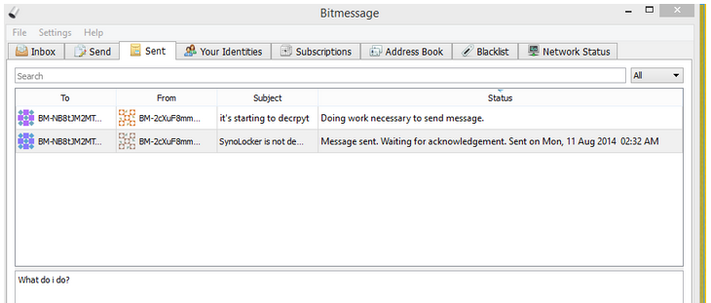

Slide 21
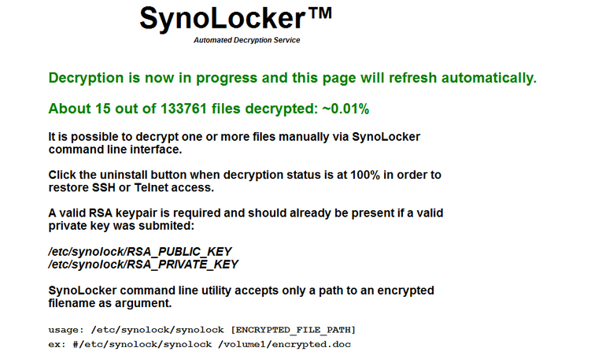

Slide 22
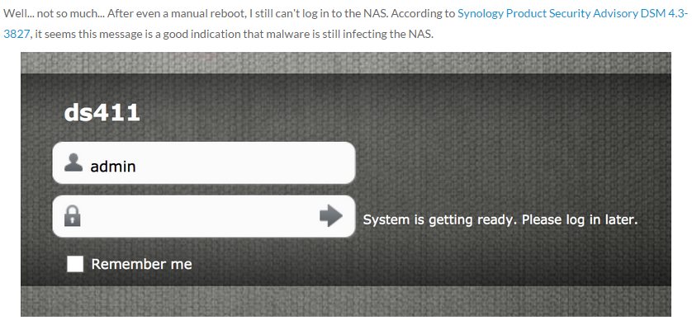
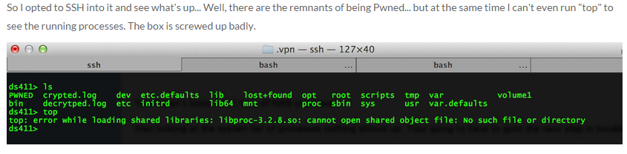

Slide 23

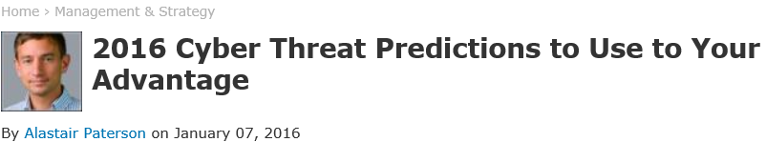
1. Attribution remains murky.
2. Ransom continues to rule.
3. More attackers share the global stage.
4. Criminals follow the money.
5. Hacktivists get more sophisticated.
6. Dark web marketplaces scramble for leadership.
7. Attacks on the retail industry evolve.
http://www.securityweek.com/2016-cyber-threat-predictions-use-your-advantage
Notes:
1. Attribution remains murky. Last year both the variety of threat actors and the ability to neatly “classify” these actors into types became much more difficult as attack behaviors changed, and motivations and threats increased in their complexity. Actors no longer work in set groups, but combine with others, involve multiple individuals, and use facades to hinder attribution. This all but ensures that attribution will be even more challenging in 2016.
2. Ransom continues to rule. Extortion as a mode of attack became a popular tactic for threats actors in 2015, and on a few occasions attackers have taken it to the level of demanding that businesses shut down entirely. Having proven that this is a profitable enterprise, attackers will likely further innovate their business models based on ransom and extortion in 2016.
3. More attackers share the global stage. Advanced attack methods, such as custom malware or unusual attack vectors, were historically the domain of nation states with significant engineering capability; often those states that have or are developing a nuclear defense capability. In 2015, non-nuclear states and organized criminal groups adopted these techniques thanks to lower barriers to entry and the increased trade in espionage capabilities. We can safely expect that in 2016 non-nuclear states will continue to develop their cyber capabilities and compete on the global stage.
4. Criminals follow the money. Organized criminals are focusing more intently on high value targets that provide a large value single payout. This is in contrast to the traditional consumer-focused malware approach that these groups have exploited in the past. This is highlighted even more with the Carbanak/Anunak attacks. Examples of high value/low volume transactions that may be targeted in 2016 are payroll, mortgages, and investment transactions.
5. Hacktivists get more sophisticated. Hacktivists continue to be motivated by embarrassment of their targets, but their tactics are no longer simply DDoS, doxing, and defacement. In 2015 hacktivists stole and published data in order to attract awareness to their cause, continuing to embarrass their targets despite the collateral damage. In 2016 hacktivists will use more tactics, techniques and procedures that were previously considered the preserve of cyber criminals.
6. Dark web marketplaces scramble for leadership. Global law enforcement will continue to takedown large dark web marketplaces. This will likely lead to a fragmentation of the market and rival marketplaces scrambling for pole position. This means that in 2016 we can expect the dark web will move to employ overlay networks other than Tor.
7. Attacks on the retail industry evolve. Spurred by the recent requirements for EMV chip card compliance, cyber criminals will continue to develop more sophisticated Point-Of-Sale (POS) malware.

Slide 24
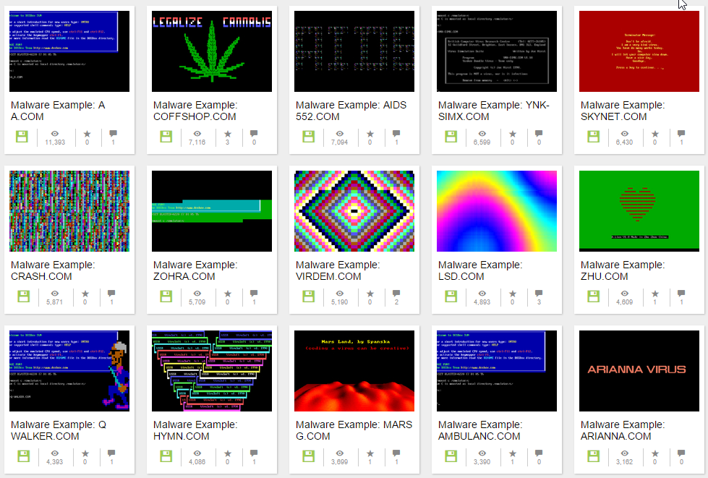
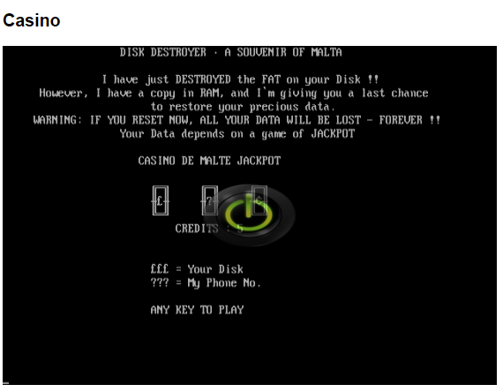
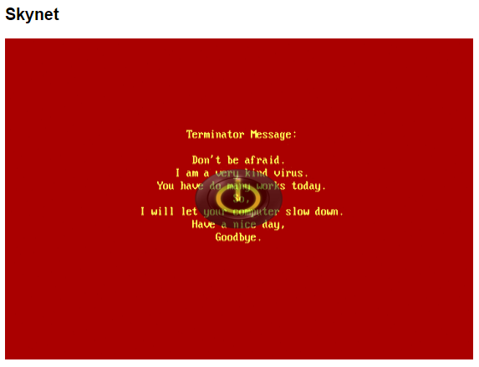
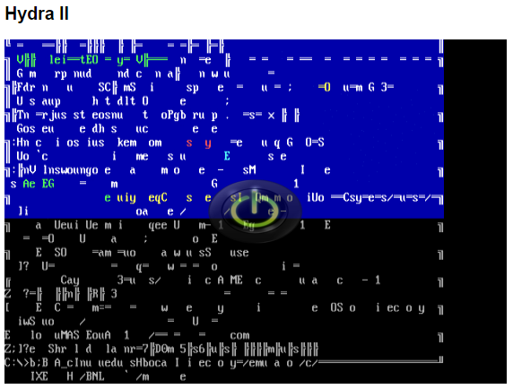

http://www.theregister.co.uk/2016/02/05/malware_museum/
78 Samples….. Safe Fun…… https://archive.org/details/malwaremuseum
Notes:
Casino
Casino was discovered in 1991, and it infects .COM programs, particularly COMMAND.COM. It is believed to have been written in Malta. When an infected executable is run, Casino installs itself quietly at the top of the PC's memory.
On January 15, April 15, and August 15, Casino will copy the hard drive's file system table into memory, delete the table from the disk, and force the user to play a slot machine game. If you hit the jackpot, the table is written back to the drive, so you get to keep your data intact. If you lose, Casino writes garbage to the file allocation table, destroying the file system unless you somehow manage to piece it back together with recovery tools.
Skynet
Skynet was developed in China and discovered in 1994. it infects programs, and stays resident in memory. When an infected .COM file is run, Skynet is triggered: it takes over the PC, displays a message reference kickass 1990s sci-fi flick The Terminator, and then slow your computer down – or make it randomly hang. Annoying if you're trying to get work done.
Hydra II
This is a classic old-school virus that would take over your screen and make all the letters and symbols swirl and cavort until there's nothing left on the display except a black oblivion – a terrifying experience if you're putting the finishing touches to an important document. The Hydra family of malware was discovered in 1991, and it infects .COM files. It doesn't do anything except replicate and fuel the imagination of Hollywood screenwriters.

Slide 25
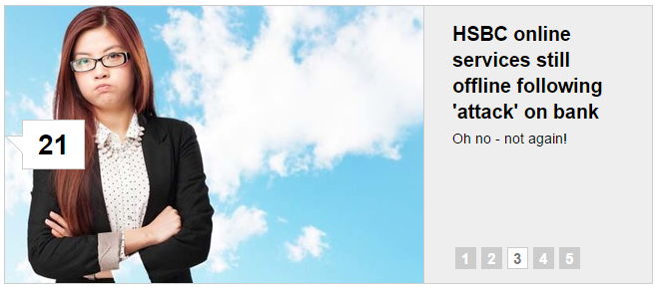
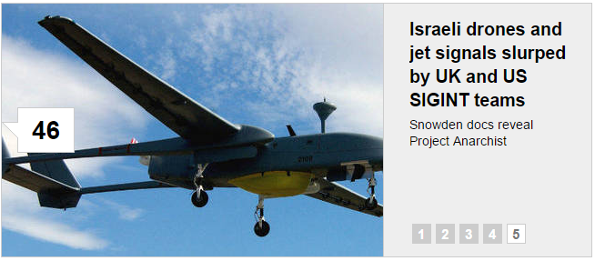
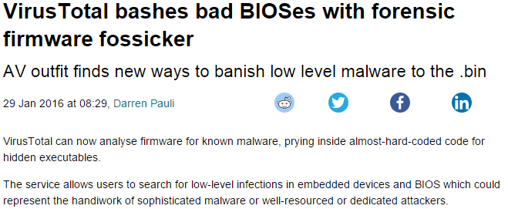
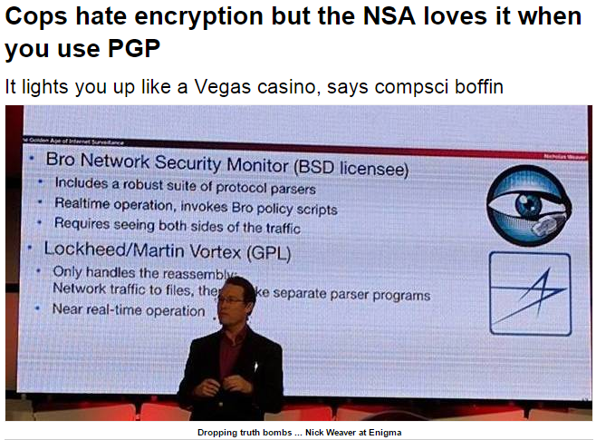
http://www.theregister.co.uk/security/

Slide 26
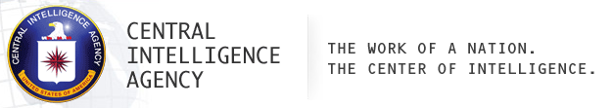
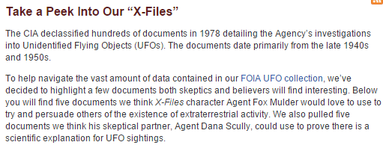
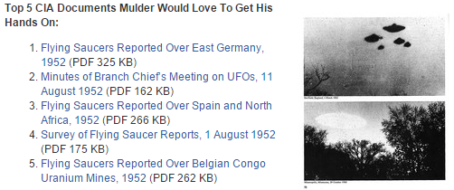
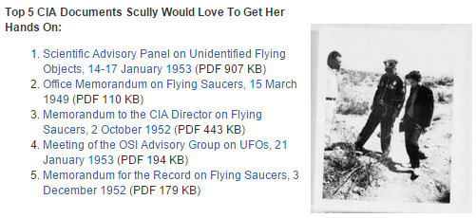
https://www.cia.gov/news-information/blog/2016/take-a-peek-into-our-x-files.html

Slide 27
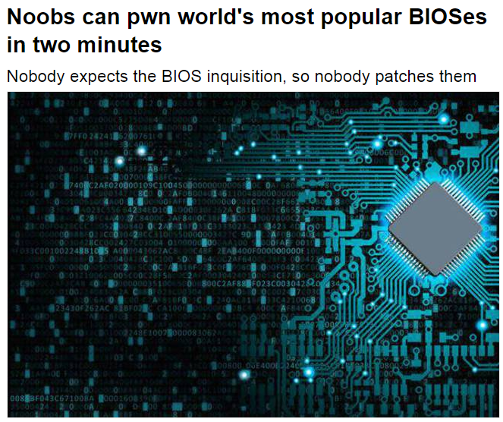
Notes:
19 Mar 2015 at 01:31, Darren Pauli
http://www.theregister.co.uk/2015/03/19/cansecwest_talk_bioses_hack/
Millions of flawed BIOSes can be infected using simple two-minute attacks that don't require technical skills and require only access to a PC to execute.
Basic Input/Output Systems (BIOS) have been the target of much hacking research in recent years since low-level p0wnage can grant attackers the highest privileges, persistence and stealth.
LegbaCore researchers Xeno Kopvah and Corey Kallenberg revealed the threat to El Reg ahead of a presentation How Many Million BIOSes Would You Like to Infect? at CanSecWest tomorrow.
"Because almost no one patches their BIOSes, almost every BIOS in the wild is affected by at least one vulnerability, and can be infected," Kopvah says.
"The high amount of code reuse across UEFI BIOSes means that BIOS infection can be automatic and reliable.
"The point is less about how vendors don't fix the problems, and more how the vendors' fixes are going un-applied by users, corporations, and governments."
Kopvah and Kallenberg's talk aims to both highlight the dangers and capabilities of BIOS attacks and the need for system administrators to apply vendor patches, something which they say is not being done.
They will demonstrate attacks against BIOS on Gigabyte, Acer, MSI, HP, and Asus, using the LightEater implant running the privacy-focused Tails platform to siphon GPG keys from memory to a flash chip.
LightEater, according to Kopvah, reveals the naïveté of claims that Tails and other live operating systems can protect users from dedicated or nation-state attackers.
The LightEater attack would take an unskilled attacker such as a maid or border guard two minutes of physical access to a target laptop.
"Then we'll boot up the infected HP system and show how LightEater can use the Intel Serial Over LAN technology to exfiltrate data from SMM (System Management Mode), without needing a NIC-specific driver. And we'll show the uber1337 'rot13' encryption which will blind network defenders to what the SMM attacker is exfiltrating," he says.
Kopvah says misconfigured BIOS access controls present more of a threat than vulnerabilities such as exploitable buffer overflows.
Those flaws are homogeneous. Using tiny signatures built from 10 machines the pair found the code hooks attackers need to build reliable SMM implants across thousands of BIOS images.
"This shows empirically that attackers wouldn't have to reverse engineer each BIOS model or revision. Simple pattern matching can make it so that tools can just assemble BIOS implants for any model on demand," Kopvah says, adding he expects that attackers already know this.
The need for better BIOS security is "starting to sink in" with top vendors (Lenovo, Dell and HP) moving to squash flaws in their gear. ASUS Kopvah says a good example of those which had not patched or acknowledged BIOS flaws.
Some BIOSes are woefully insecure. The pair found Giagbyte's BIOS had borked access controls that did nothing to prevent attacks.
"So, we didn't even have to do anything special; we just had a kernel driver write an invalid instruction to the first instruction the CPU reads off the flash chip, and bam, it was out for the count, and never was able to boot again," Kopvah says.
The duo will reveal an automated scripts they supplied to vendors that can detect dangerous attacks against SMM capable of reading and writing to all system memory.
BIOS attacks surfaced on the public record from the research community but as leaked Snowden documents reveal it was the National Security Agency that likely first exploited the vector.
The research pair says the attacks should serve as a boot in the arse for governments and corporations to apply BIOS patches if only to make life more difficult for less-resourced hostile spy agencies.
"I personally find it very ironic that things like Tails gained popularity as OPSEC tools thanks to Snowden, while at the same time Snowden's leaks showed that the NSA had the capability to defeat such mechanisms if they wanted to." ®

Slide 28
Why Security is Hot

Slide 29
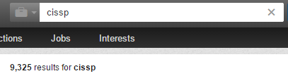
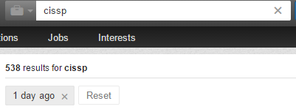
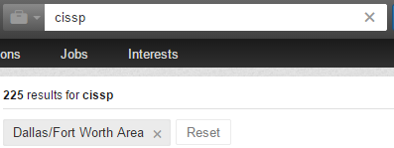
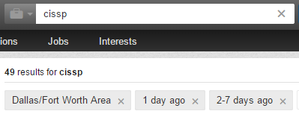


Slide 30


Slide 31
Access Control

Slide 32
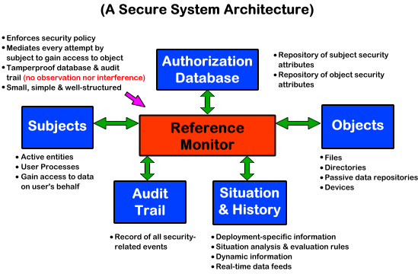
Understand This. It’s this simple.

Slide 33
Components of Access Control
Identification
Subjects supplying identification information
Username, user ID, account number
Authentication
Verifying the identification information
Passphrase, PIN value, biometric, one-time password, password
Authorization
Using criteria to make a determination of operations that subjects can carry out on objects
“I know who you are, now what am I going to allow you to do?”
Accountability
Audit logs and monitoring to track subject activities with objects

Slide 34
Identification
Identifies a user uniquely
Identification must be unique for accountability
Standard naming schemes should be used
Identifier should not indicate extra information about user (like job position)

Slide 35
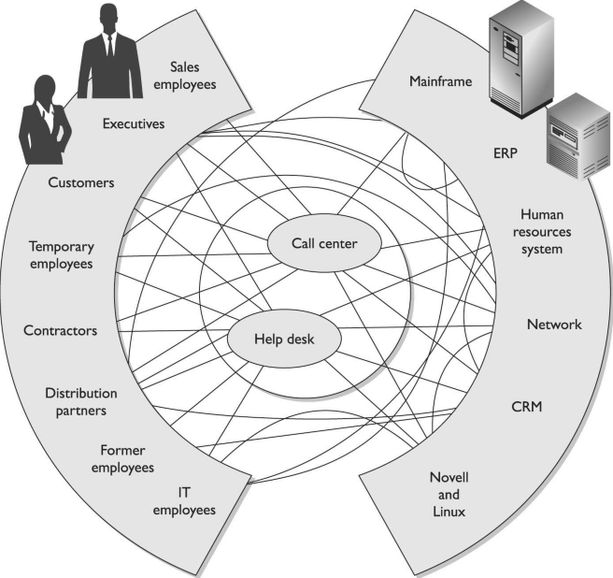
Identity Management IS HARD.
It’s a broad term.
Analogy of four blind men trying to describe an elephant.
Subjects
Objects

Slide 36
Authentication
Proving who you say you are, usually one OR MORE of these 3
Something you know
Something you have
Something you are

Slide 37
Strong Authentication
Strong Authentication is the combination of 2 or more of these and is encouraged!
Strong Authentication provides a higher level of assurance
Strong Authentication is also called multi-factor authentication
Something that you know
Something that you are
Something that you have

Slide 38
Authorization
The concept of ensuring that someone who is authenticated is allowed access to a resource.
Authorization is a preventative control*

Slide 39
Accounting or Auditing
Logging and reviewing accesses to objects.
What is the purpose of auditing?
Auditing is a detective control*

Slide 40
Passwords

Slide 41
Passwords
Password – A protected string of characters that one uses to authenticate themselves.
Password authentication is:
Something you know

Slide 42
Problems with Passwords
People write down passwords
People use weak passwords
People re-use passwords
If you make passwords to hard to remember then people write them down
If you make them too easy then they are easily cracked

Slide 43
PART 2

Slide 44
Breaking Passwords
Top 10 Password Cracking Methods
Cain
Offline NT Password & Registry Editor
Creating Strong Passwords
The Myth of Creating Strong Passwords
Storing Unique Passwords

Slide 45
Top 10 Password Cracking Methods
http://www.alphr.com/features/371158/top-ten-password-cracking-techniques

Slide 46
Top 10 Password Cracking Methods
1. Dictionary attack – e.g. “password”
2. Brute force attack – e.g. “a, aa, ab, ac…”
3. Rainbow table attack – precomputed hashes
4. Phishing – typically email
5. Social engineering – e.g. phone call
6. Malware – e.g. from websites
7. Offline cracking – taking time
8. Shoulder surfing – watching
9. Spidering – slurping open sources
10. Guess – intelligent deduction
Notes:
1. Dictionary attack
This uses a simple file containing words that can, surprise surprise, be found in a dictionary. In other words, if you will excuse the pun, this attack uses exactly the kind of words that many people use as their password.
Cleverly grouping words together such as ‘letmein’ or ‘superadministratorguy’ will not prevent your password from being cracked this way - well, not for more than a few extra seconds.
2. Brute force attack
This method is similar to the dictionary attack but with the added bonus, for the hacker, of being able to detect non-dictionary words by working through all possible alpha-numeric combinations from aaa1 to zzz10.
It’s not quick, provided your password is over a handful of characters long, but it will uncover your password eventually. Brute force attacks can be shortened by throwing additional computing horsepower, in terms of both processing power - including harnessing the power of your video card GPU - and machine numbers, such as using distributed computing models and zombie botnets.
3. Rainbow table attack
A rainbow table is a list of pre-computed hashes - the numerical value of an encrypted password, used by most systems today - and that’s the hashes of all possible password combinations for any given hashing algorithm mind. The time it takes to crack a password using a rainbow table is reduced to the time it takes to look it up in the list.
Blogs
How a cheap graphics card could crack your password in under a second
However, the table itself will be huge and require some serious computing horse power to run, and it’s useless if the hash it is trying to find has been ‘salted’ by adding random characters to the password before applying the hashing algorithm.
There is talk of salted rainbow tables existing, but these would be so large as to be difficult to use in practise. They would likely only work with a predefined ‘random character’ set and password strings below 12 characters as the size of the table would be prohibitive to even state-level hackers otherwise.
4. Phishing
There's an easy way to hack: ask the user for his or her password. A phishing email leads the unsuspecting reader to a faked online banking, payment or other site in order to login and put right some terrible problem with their security.
Why bother going to the trouble of cracking the password when the user will happily give it you anyway?
5. Social engineering
Social engineering takes the whole ‘ask the user’ concept outside of the inbox that phishing tends to stick with and into the real world.
A favourite of the social engineer is to telephone an office posing as an IT security tech guy and simply ask for the network access password. You’d be amazed how often this works. Some even have the necessary gonads to don a suit and name badge before walking into a business to ask the receptionist the same question face to face.
The most confident of hackers will take the guise of a parcel courier, aircon service technician or anything else that gets them access to an office building.
Once they are in, the service personnel ‘uniform’ provides a kind of free pass to wander around unhindered, and make note of passwords being entered by genuine members of staff. It also provides an excellent opportunity to eyeball all those post-it notes stuck to the front of LCD screens with logins scribbled upon them.
6. Malware
A key logger or screen scraper can be installed by malware which records everything you type or takes screen shots during a login process, and then forwards a copy of this file to hacker central.
Some malware will look for the existence of a web browser client password file and copy this which, unless properly encrypted, will contain easily accessible saved passwords from the user's browsing history.
7. Offline cracking
It’s easy to imagine that passwords are safe when the systems they protect lock out users after three or four wrong guesses, blocking automated guessing applications. Well, that would be true if it were not for the fact that most password hacking takes place offline, using a set of hashes in a password file that has been ‘obtained’ from a compromised system.
Often the target in question has been compromised via an hack on a third party, which then provides access to the system servers and those all-important user password hash files. The password cracker can then take as long as they need to try and crack the code without alerting the target system or individual user.
8. Shoulder surfing
The most confident of hackers will take the guise of a parcel courier, aircon service technician or anything else that gets them access to an office building.
Once they are in, the service personnel ‘uniform’ provides a kind of free pass to wander around unhindered, and make note of passwords being entered by genuine members of staff. It also provides an excellent opportunity to eyeball all those post-it notes stuck to the front of LCD screens with logins scribbled upon them.
9. Spidering
Savvy hackers have realised that many corporate passwords are made up of words that are connected to the business itself. Studying corporate literature, website sales material and even the websites of competitors and listed customers can provide the ammunition to build a custom word list to use in a brute force attack.
Really savvy hackers have automated the process and let a spidering application, similar to those employed by leading search engines to identify keywords, collect and collate the lists for them.
10. Guess
The password crackers best friend, of course, is the predictability of the user. Unless a truly random password has been created using software dedicated to the task, a user generated ‘random’ password is unlikely to be anything of the sort.
Instead, thanks to our brains' emotional attachment to things we like, the chances are those random passwords are based upon our interests, hobbies, pets, family and so on. In fact, passwords tend to be based on all the things we like to chat about on social networks and even include in our profiles. Password crackers are very likely to look at this information and make a few - often correct - educated guesses when attempting to crack a consumer-level password without resorting to dictionary or brute force attacks.

Slide 47
CAIN
http://www.oxid.it/cain.html

Slide 48
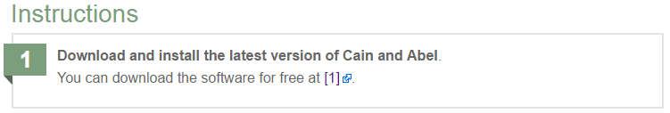


Slide 49


Slide 50


Slide 51

Decide if you want to use a dictionary attack or a brute force attack. If you want to use a dictionary attack then choose the existing dictionary or go download dictionary.
Example dictionaries
https://wiki.skullsecurity.org/Passwords

Slide 52


Slide 53


Slide 54


Slide 55
Offline NT Password & Registry Editor
https://pogostick.net/~pnh/ntpasswd/

Slide 56




Offline NT Password & Registry Editor

Slide 57
Creating Strong Passwords
https://www.schneier.com/blog/archives/2013/06/a_really_good_a.html

Slide 58
Password Management
Proper Password Management, including password policies can help mitigate some of the problems with passwords.
First choose a strong password!
Minimum password lengths - 8
Case changes, number and special characters
1 or more A-Z
1 or more a-z
1 or more 0-9
1 or more special character
No personal information (usernames, real name, children's names, birthdates)

Slide 59
Passphrases
So if you want your password to be hard to guess […] take a sentence and turn it into a password. Something like "This little piggy went to market" might become "tlpWENT2m". That nine-character password won't be in anyone's dictionary. Of course, don't use this one, because I've written about it. Choose your own sentence -- something personal.
Until this very moment, these passwords were still secure:
WIw7,mstmsritt... = When I was seven, my sister threw my stuffed rabbit in the toilet.
Wow...doestcst::amazon.cccooommm = Wow, does that couch smell terrible.
Ltime@go-inag~faaa! = Long time ago in a galaxy not far away at all.
uTVM,TPw55:utvm,tpwstillsecure = Until this very moment, these passwords were still secure.

Slide 60
One Time Password
Password that is used only once then no longer valid
Used in high security environments
VERY secure
Not vulnerable to electronic eavesdropping, but vulnerable to loss of token.
Require a token device to generate passwords. (RSA SecureID key is an example)

Slide 61
The Myth of Creating Strong Passwords

Slide 62
Static Keys Can Be Copied
Door Key.
Same password all sites.
ALL sites?
Really?
No. Seriously.
Bad Idea.

Slide 63
Storing Unique Passwords

Slide 64

http://keepass.info

Slide 65


Slide 66


Slide 67


Slide 68


Slide 69


Slide 70
PART 3

Slide 71
Breaking Systems
Why You Have the Advantage
Ring Theory & Real-World Examples
Social Engineering
Resources
Metasploit Demonstration

Slide 72
Engineering is Hard.

Slide 73








Images Source: http://www.white.at/projectjennifer/images/forumad/Azorian_forumad.jpg
Notes:
To this day, Project Azorian is the deepest ocean salvage operation ever attempted and challenged a team of Americas elite marine and aero-space companies to design a unique system to solve an incredible problem, how do you lift to the surface a damaged 1,700 ton segment of submarine from a depth of 3 miles while being observed by a paranoid and well-armed Soviet intelligence organization?

Slide 74
Why You Have the Advantage

Slide 75
Complexity
Psychology
Supply Chain
Skill Set
Resources
Time
Politics
Naivety

Slide 76
Data Breach Sources
Open Security Foundation: datalossdb and osvdb (http://www.opensecurityfoundation.org/ )
Computer Security Institute (CSI): http://gocsi.com/
Office of Inadequate Security: http://www.databreaches.net/
Identity Theft Resource Center: http://www.idtheftcenter.org/
ISACA: www.isaca.org
ISSA: www.issa.org
Mitre Corporation: www.mitre.org
OWASP: http://owasp.com/index.php/Main_Page
Privacy Rights Clearing House: http://www.privacyrights.org/
SANS: www.sans.org
The Ponemon Institute: www.ponemon.org
www.databreachcalculator.com.
List Compiled by: Patrick Florer

Slide 77
Ring Theory & Real-World Examples

Slide 78
Social Engineering

Slide 79




Slide 80
Resources

Slide 81
Penetration Testing Methodologies
Open Source Security Testing Methodology Manual
(OSSTMM)
http://www.isecom.org/
NIST National Institute of Standards and Technology
(SP 800-42) Guideline on Network Security Testing
http://csrc.ncsl.nist.gov/publications/nistpubs/index.html
Federal Financial Institutions Examination Council (FFIEC)
Information Technology Examination
http://www.ffiec.gov/ffiecinfobase/index.html 4FFIEC
Information Security Booklet
Information Systems Security Assessment Framework (ISSAF)
http://www.oissg.org/

Slide 82
Metasploit Demonstration

Slide 83
Resources

Slide 84
Resources
https://www.metasploit.com

Slide 85
Final Thoughts

Slide 86
Final Thoughts

Slide 87
Chris Davis
UTD Email: cmd140430@utdallas.edu
Google Voice: 214-771-8122

Slide 88
From Authorities to Audits
Examples
Technical, physical, and administrative requirements that must be in place to ensure compliance with the authorities
Statements of how a company will implement and enforce requirements
Implementation of the technical, physical, and administrative requirements found in the policy statements
Verification of appropriately implemented controls to comply with requirements
PCI
HIPAA
NERC
Authorities
Requirements
Policies
Controls
Audits
PCI-DSS Example
Authority: PCI-DSS is the authority document created by the PCI-SSC.
Requirement: (10.6) Review logs for all system components at least daily.
Policy: Monitoring Policy – States logs will be reviewed at least daily.
Control: Tool XYZ provides real-time monitoring for all system components.
Audit: Auditor verifies Tool XYZ is appropriately monitoring and alerting to actionable events. Audit results and evidence are stored as part of the audit.

Slide 89
Effectively Managed IT Controls
Technology can affect every part of the business.
At its best, technology is a competitive advantage.
At its worst, technology is your competitor’s advantage.
Product
Market Relationships
IT Controls:
Detective, protective and reactive measures in place to protect the confidentiality, integrity, and availability of business information and ensure appropriate management of the IT function to meet business objectives.
Inbound Logistics
Operations
Outbound Logistics
Marketing
and Sales
Service
Firm Infrastructure
HR Management
Margin
Procurement
Technology Development
Notes:
Compliance Control: A process, effected by management and other personnel, designed to provide reasonable assurance that transactions are executed in accordance with 1) laws governing the use of budget authority and other laws and regulations that could have a direct and material effect on the financial statements or required supplementary stewardship information and 2) any other laws, regulations, and government wide policies identified in OMB audit guidance. [GAO/PCIE Financial Audit Manual]
Source: http://www.unifiedcompliance.com/it_compliance/language_compliance/definitions/c.html

Slide 90
Additional Materials

Slide 91
One Time Password Token Type
One time passwords are one of two types that we are about to discuss.
Synchronous
Asynchronous

Slide 92
Synchronous One Time Password
Synchronous – uses time to synchronize between token and authentication server
Clocks must be synchronized!
Can also use counter-sync which a button is pushed that increments values on the token and the server

Slide 93


Synchronous One Time Password

Slide 94
Asynchronous OTP
Asynchronous
Challenge response
Auth sends a challenge (a random value called a nonce)*
User enters nonce into token, along with PIN
Token encrypts nonce and returns value
Users inputs value into workstation
If server can decrypt then you are good.

Slide 95

Challenge OTP

Slide 96
Other Types of Authentication
Other types of Authentication that we are about to discuss are
Digital Signatures
Memory Cards
Smart Cards

Slide 97
Digital Signatures
Digital Signature (talk about in more depth in chapter 8).
Take a hash value of a message, encrypt hash with your private key
Anyone with your public key can decrypt and verify message is from you.

Slide 98

Memory Cards

Slide 99
Memory Cards
NOT a smart card
Holds information, does NOT process
A memory card holds authentication info, usually you’ll want to pair this with a PIN… WHY?
A credit card or ATM card is a type of memory card, so is a key/swipe card
Usually insecure, easily copied.*

Slide 100

Smart Card

Slide 101
Smart Card
Much more secure than memory cards
Can actually process information
Includes a microprocessor and ICs
Can provide two factor authentication, as you the card can store authentication protected by a pin. (so you need the card, and you need to know something)
Two types
Contact
contactless

Slide 102


Slide 103
Smart Card Attacks
There are attacks against smart cards
1. Fault generation – manipulate environmental controls and measure errors in order to reverse engineer logic etc.
(more)
Notes:
Over the years, people have become very inventive in the development of various ways to attack smart cards. For example, individuals have introduced computational errors into smart cards with the goal of uncovering the encryption keys used and stored on the cards. These “errors” are introduced by manipulating some environmental component of the card (changing input voltage, clock rate, temperature fluctuations). The attacker reviews the result of an encryption function after introducing an error to the card, and also reviews the correct result, which the card performs when no errors are introduced. Analysis of these different results may allow an attacker to reverse-engineer the encryption process, with the hope of uncovering the encryption key. This type of attack is referred to as fault generation.
Harris, Shon (2012-11-08). CISSP All-in-One Exam Guide, 6th Edition (Kindle Locations 4472-4477). McGraw-Hill Education. Kindle Edition.

Slide 104
Smart Card Attacks
2. Side Channel Attacks – Measure the cards while they work
Differential power analysis – measure power emissions
Electromagnetic analysis – example frequencies emitted
(more)
Notes:
Side-channel attacks are nonintrusive and are used to uncover sensitive information about how a component works, without trying to compromise any type of flaw or weakness. As an analogy, suppose you want to figure out what your boss does each day at lunch time but you feel too uncomfortable to ask her. So you follow her, and you see she enters a building holding a small black bag and exits exactly 45 minutes later with the same bag and her hair not looking as great as when she went in. You keep doing this day after day and come to the conclusion that she must be working out. Now you could have simply read the sign on the building that said “Gym,” but we will give you the benefit of the doubt here and just not call you for any further private investigator work.
Harris, Shon (2012-11-08). CISSP All-in-One Exam Guide, 6th Edition (Kindle Locations 4477-4483). McGraw-Hill Education. Kindle Edition.

Slide 105
Smart Card Attacks
3. Micro probing* - using needles to vibrations to remove the outer protection on the cards circuits. Then tap into ROMS if possible or “die” ROMS to read data.
Notes:
Microprobing uses needleless and ultrasonic vibration to remove the outer protective material on the card’s circuits. Once this is completed, data can be accessed and manipulated by directly tapping into the card’s ROM chips.
Harris, Shon (2012-11-08). CISSP All-in-One Exam Guide, 6th Edition (Kindle Locations 4495-4497). McGraw-Hill Education. Kindle Edition.

Slide 106
Access Control Layers

Slide 107
Controls and Control Types*
There are Controls and Control types, need to understand these.
Controls:
Administrative
Physical
Technical

Slide 108
Administrative Controls
HR practices
Management practices (supervisor, corrective actions)
Training
Testing – not technical, and management’* responsibility to ensure it happens

Slide 109
Physical Controls
Physical Network Segregation (not logical) – ensure certain networks segments are physically restricted
Perimeter Security – CCTV, fences, security guards, badges
Computer Controls – physical locks on computer equipment, restrict USB access etc.
Work Area Separation – keep accountants out of R&D areas
Cabling – shielding, Fiber
Control Zone – break up office into logical areas (lobby – public, R&D- Top Secret, Offices – secret)

Slide 110
Technical or Logical controls
Using technology to protect
System Access – Kerberos, PKI, radius (specifically access to a system)
Network Architecture – IP subnets, VLANS , DMZ
Network Access – Routers, Switches and Firewalls that control access
Encryption – protect confidentiality, integrity
Auditing – logging and notification systems.

Slide 111
Summary of Access Control Layers
Administrative Controls
Policy and procedures
Personnel controls
Supervisory structure
Security-awareness training
Testing
Physical Controls
Network segregation
Perimeter security
Computer controls
Work area separation
Data backups
Cabling
Control zone
Technical Controls
System access
Network architecture
Network access
Encryption and protocols
Auditing
Notes:
Access control consists of three broad categories: administrative, technical, and physical. Each category has different access control mechanisms that can be carried out manually or automatically. All of these access control mechanisms should work in concert with each other to protect an infrastructure and its data. Each category of access control has several components that fall within it, as shown next: • Administrative Controls • Policy and procedures • Personnel controls • Supervisory structure • Security-awareness training • Testing • Physical Controls • Network segregation • Perimeter security • Computer controls • Work area separation • Data backups • Cabling • Control zone • Technical Controls • System access • Network architecture • Network access • Encryption and protocols • Auditing
Harris, Shon (2012-11-08). CISSP All-in-One Exam Guide, 6th Edition (Kindle Locations 5267-5269). McGraw-Hill Education. Kindle Edition.
Harris, Shon (2012-11-08). CISSP All-in-One Exam Guide, 6th Edition (Kindle Locations 5260-5267). McGraw-Hill Education. Kindle Edition.

